Slide 1
Software Development based on Unity 3D game kit
小组成员：杜云滔、郁思敏

Slide 2


player
player
1. Design structure
player
cache
cache
cache
Player action
Backend online cache
Message queue
Query/update
transition
server
database

Slide 3
2. Game structure
聊天
好友
历史消息
装备
回血
佩戴
商城
交易
金币兑换
打怪
寻宝
陷阱
传送
小地图
场景一
场景二
玩家
玩家
玩家

Slide 4
3. Database schema
Player info
Name/passwd
Gold/silver number
Last login/online/last_find_treasure

Slide 5
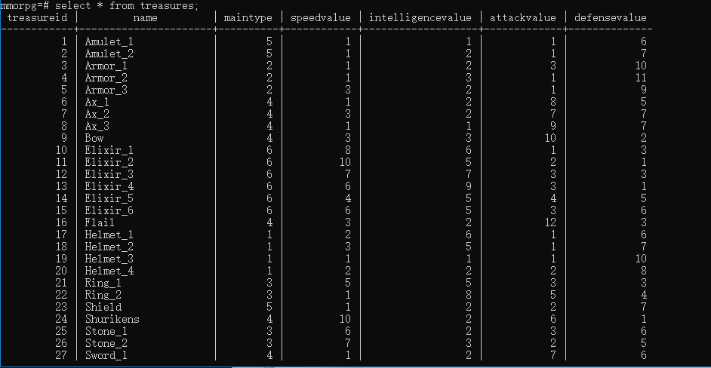
3. Database schema
Treasure attribute
Type
Attribute value

Slide 6
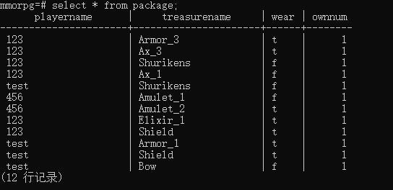
3. Database schema
Player & treasure relationship
username
Wear
Number(many to many)

Slide 7
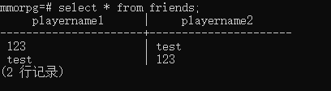
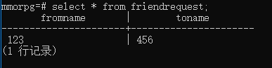
3. Database schema
Friends
Two way out
Friends request
Delete when receive message

Slide 8
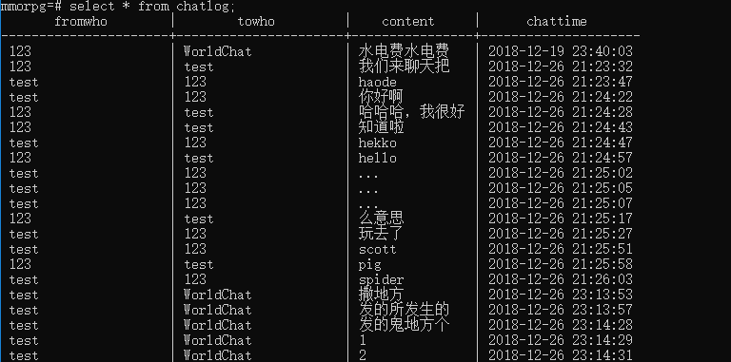
3. Database schema
Chat message
From/ to
Content
Chat time

Slide 9
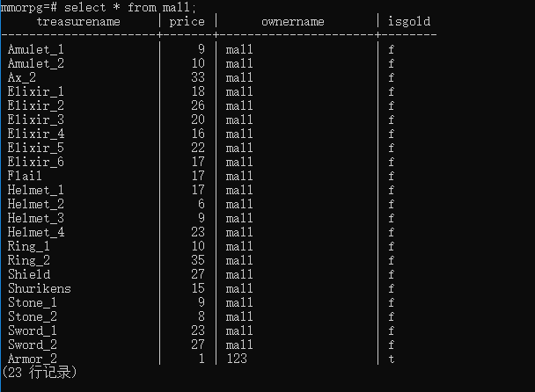
3. Database schema
Trade &sell
Treasure name
Price
Owner name(user or mall)
Isgold

Slide 10
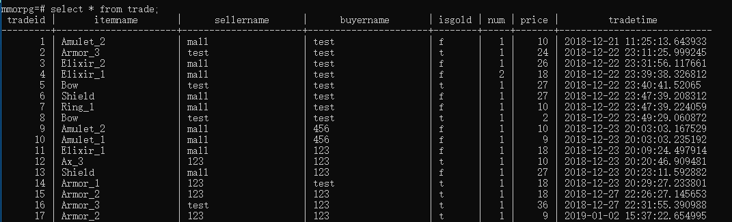
3. Database schema
Trade logs
Item/is gold/number(constrain)/price
Sell name
Trade time

Slide 11
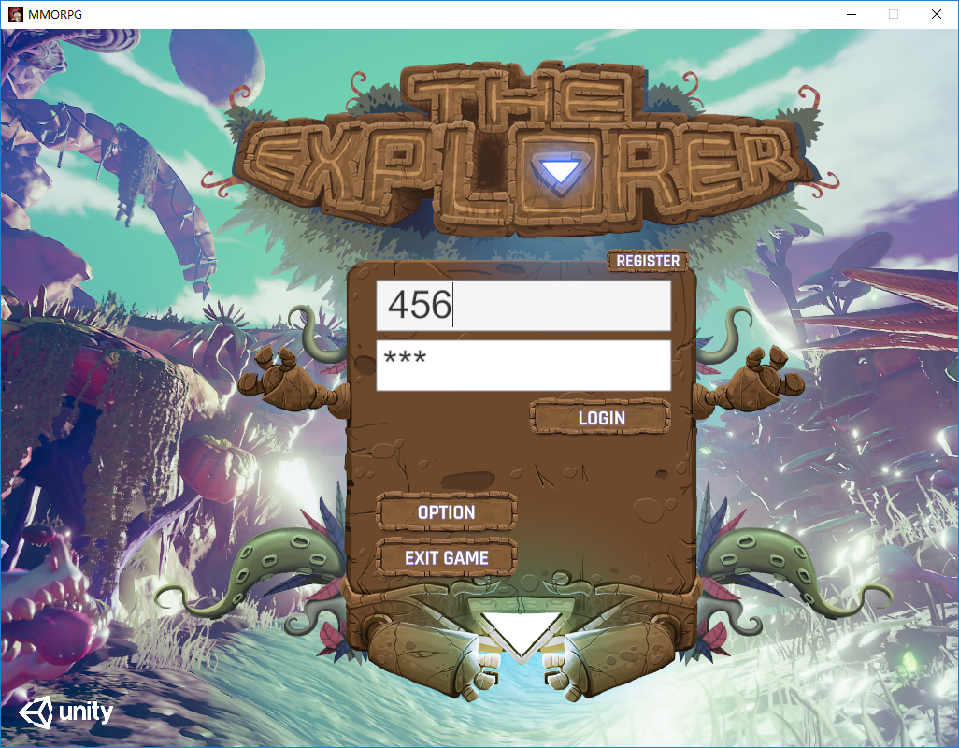
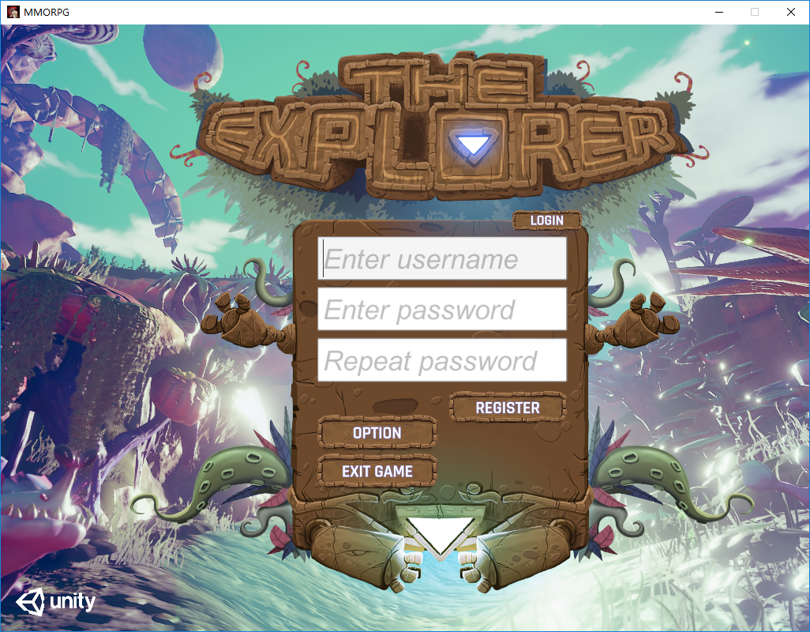
4. functions
Log/Register
Password check/protection
User exists check
User log in check
Init new user
New user login notification
Send/store player info in frontend
Store online players in backend

Slide 12
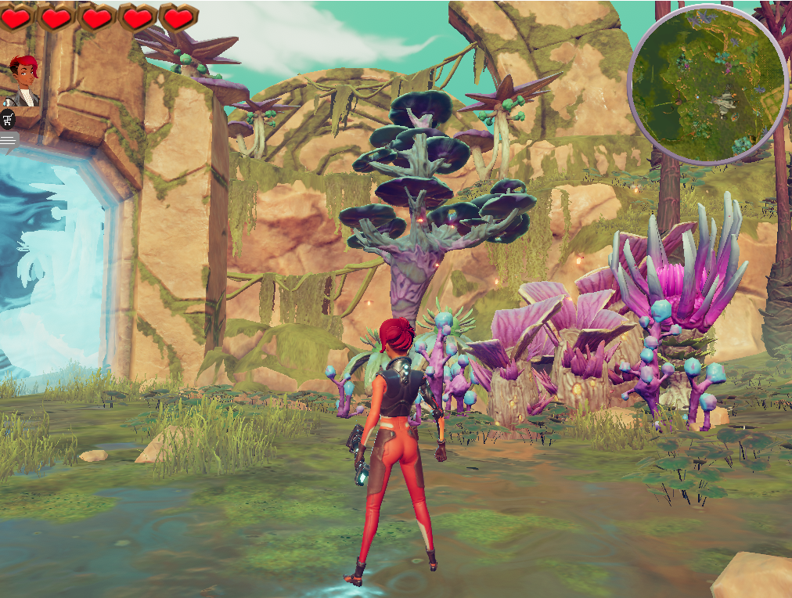
4. functions
Mini map
User orientation detection

Slide 13
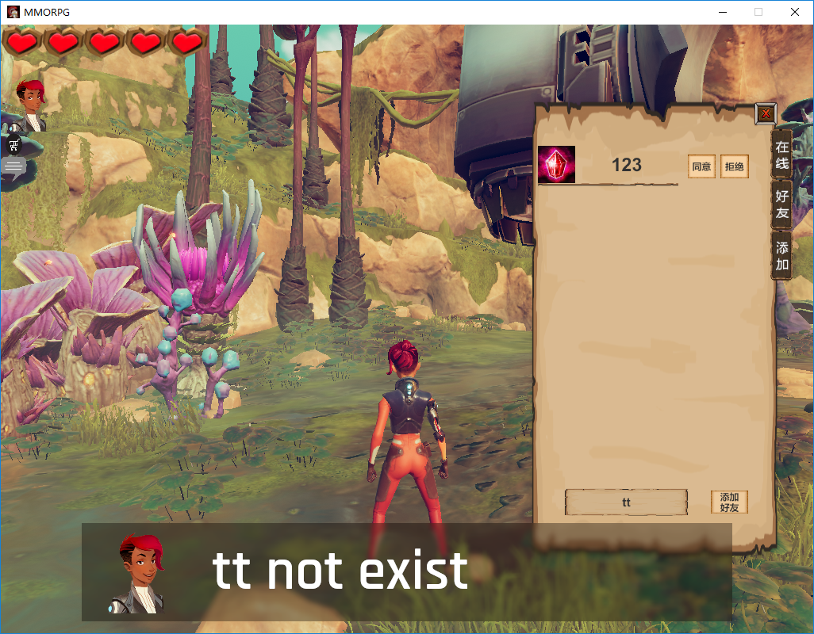
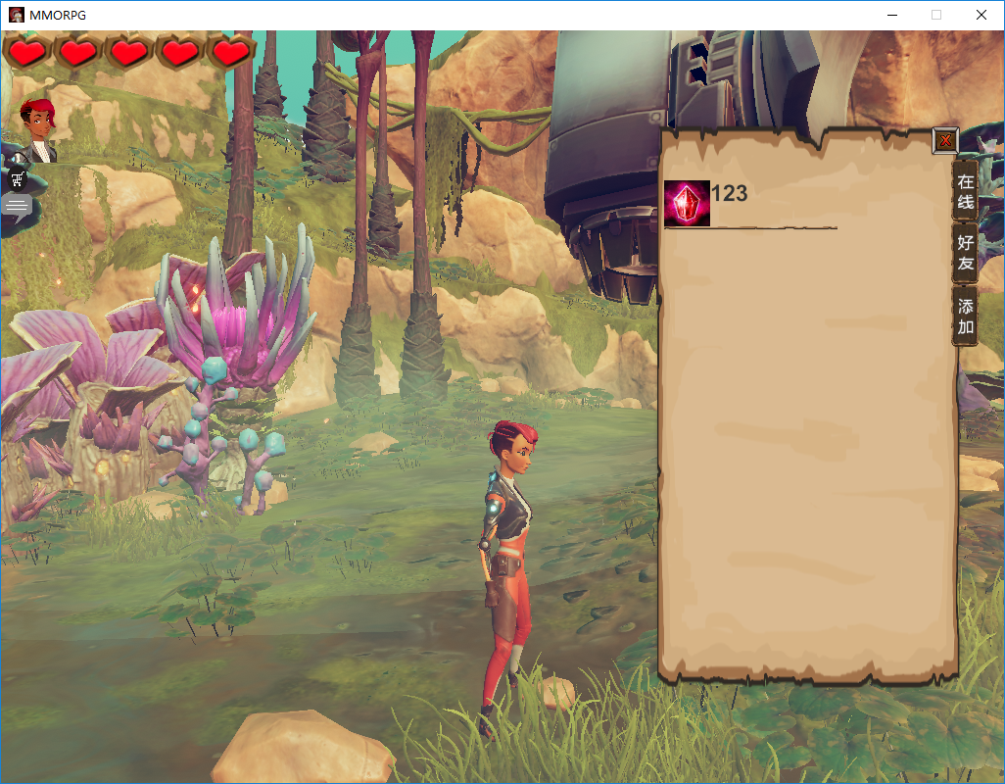
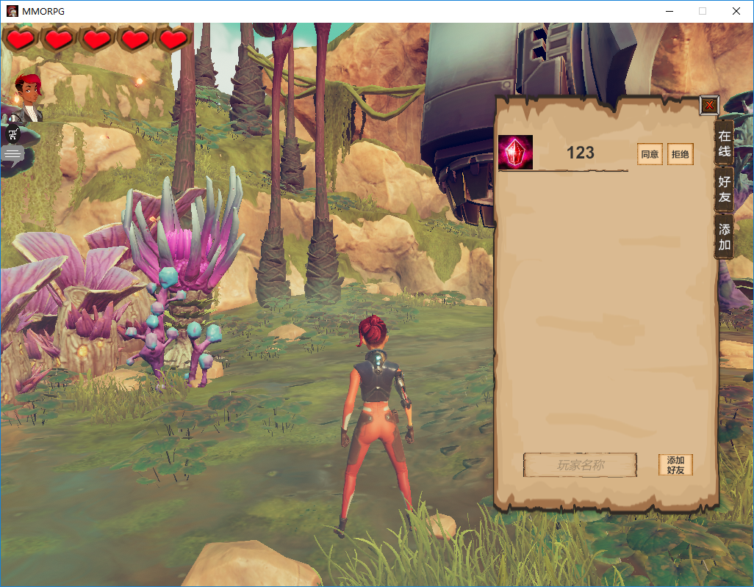
4. functions
Add friends
Find friend in game with username
Send friends requests
If not online, store in database
Accept/decline requests
Show in friends list(store relationship in db)

Slide 14
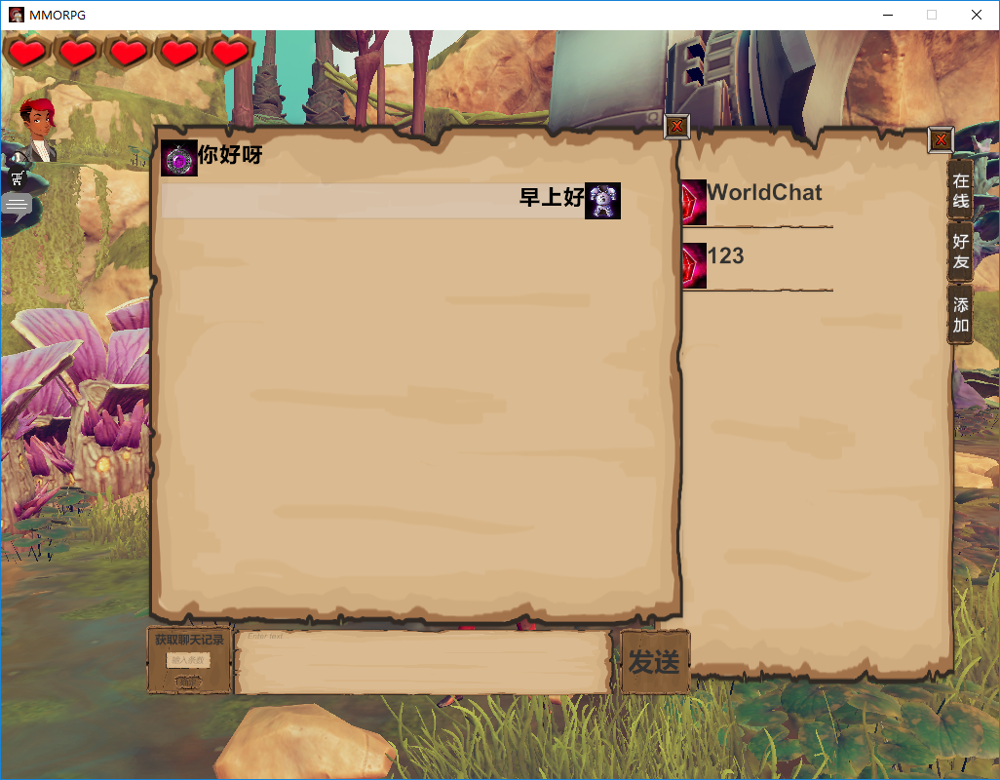
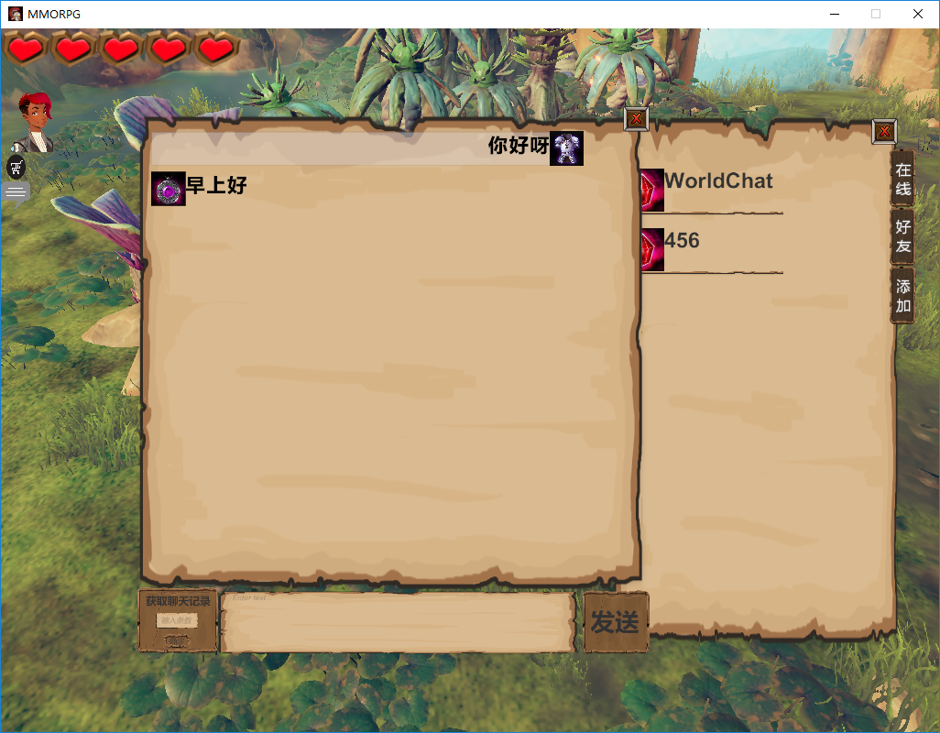
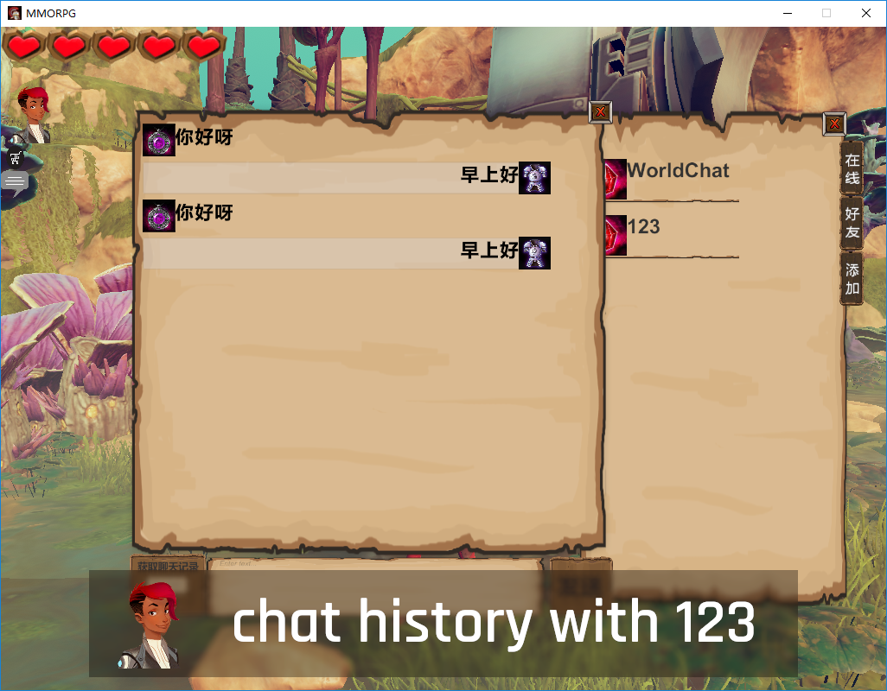
4. functions
Chat with friends
Chat with online friends
Receive message notification
Chat with World(online friends)
Chat message tips
Sync and search chat logs
Sync with background thread
Batch insert(100ms)
StringBuilder instead of string class
Search last n chat messages

Slide 15
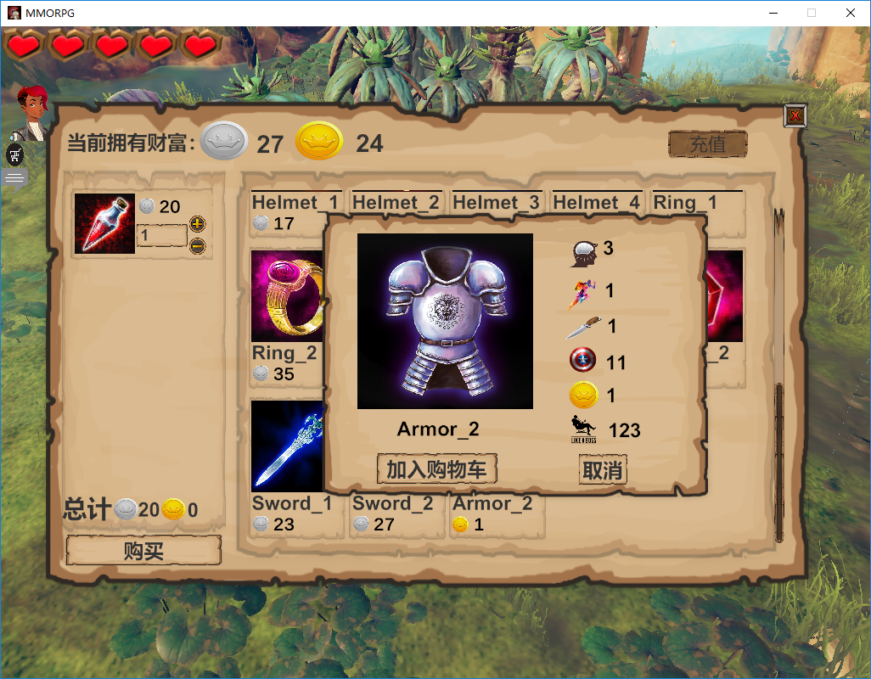
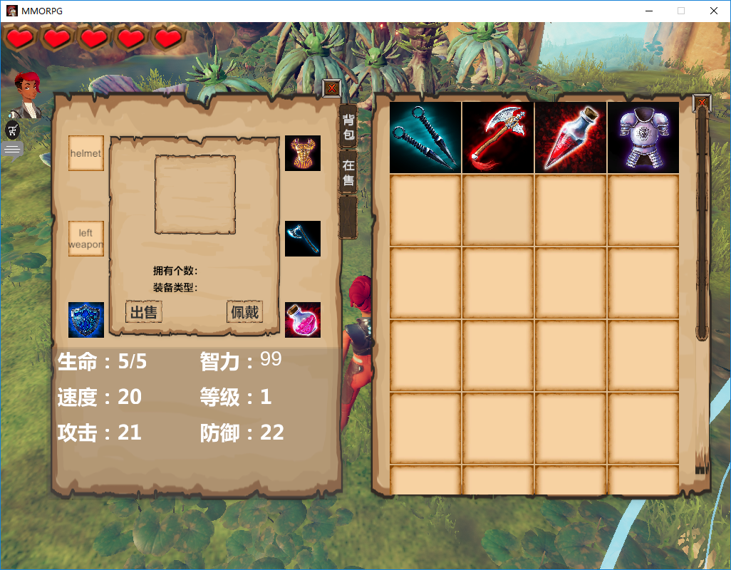
4. functions
Trade & Buy
Treasure attributes
Add to cart
Sync with backend 5 min
Gold coin
Buy unique treasure
Users treasure exchange
transition to ensure process
Silver coin
Buy treasure can be found in game
No need transition

Slide 16
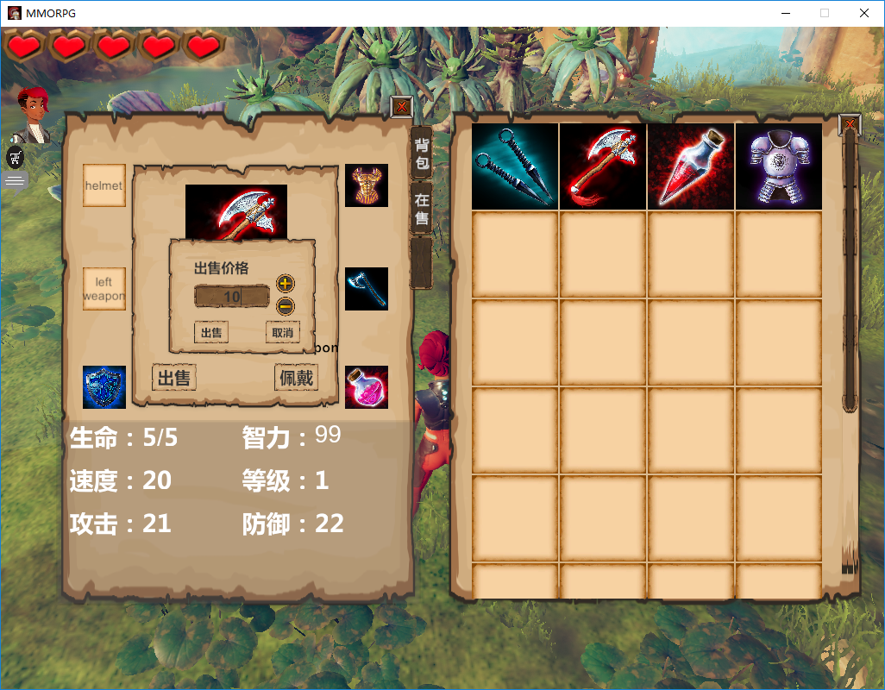
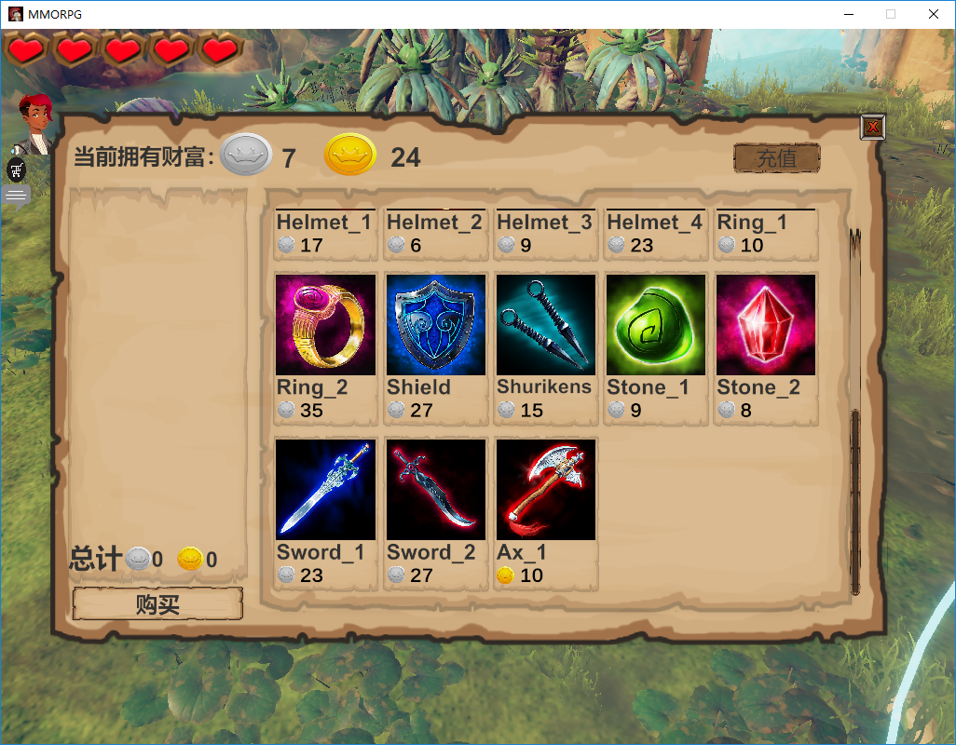
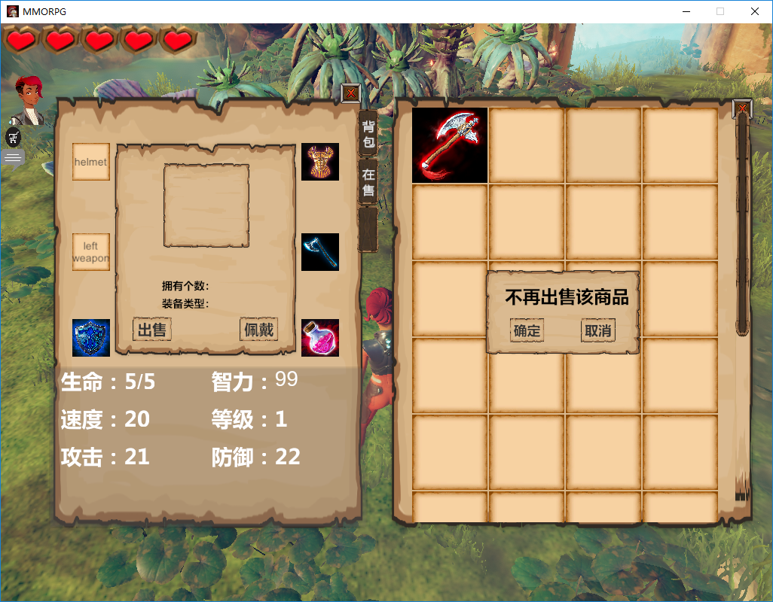
4. functions
Backpack & sell
Store personal treasure
Sell treasure with price
Show in-sell treasure

Slide 17
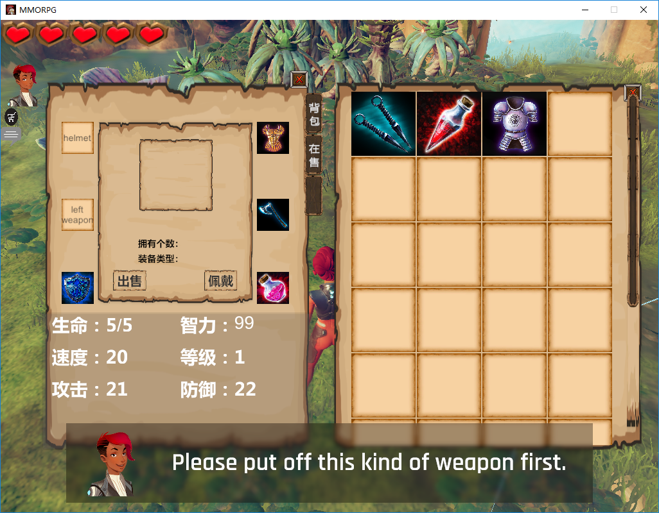
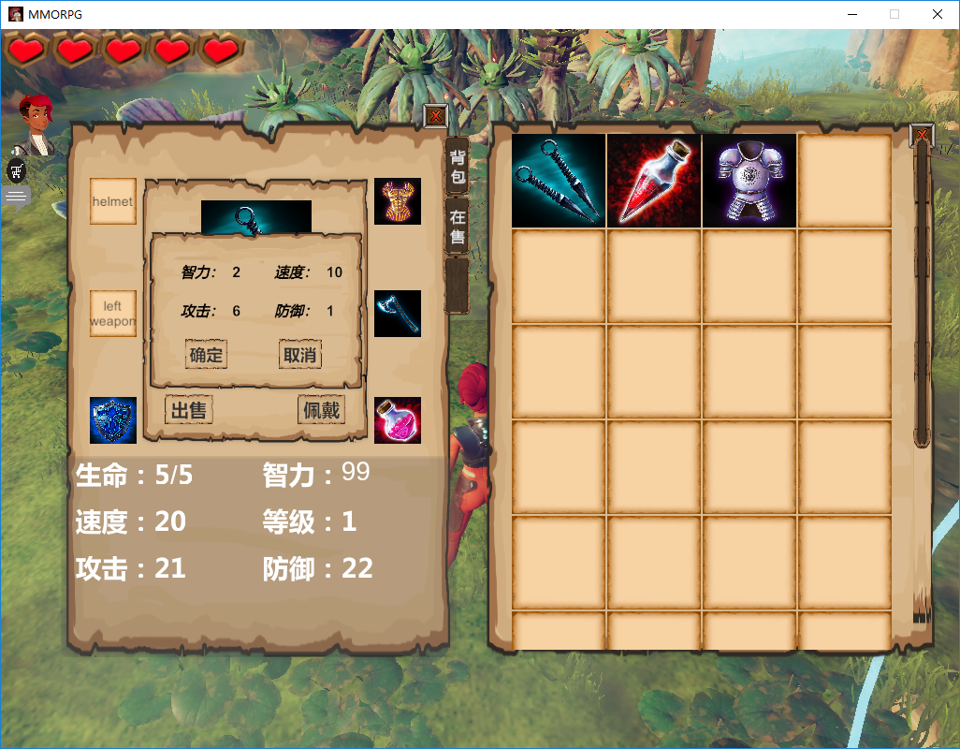
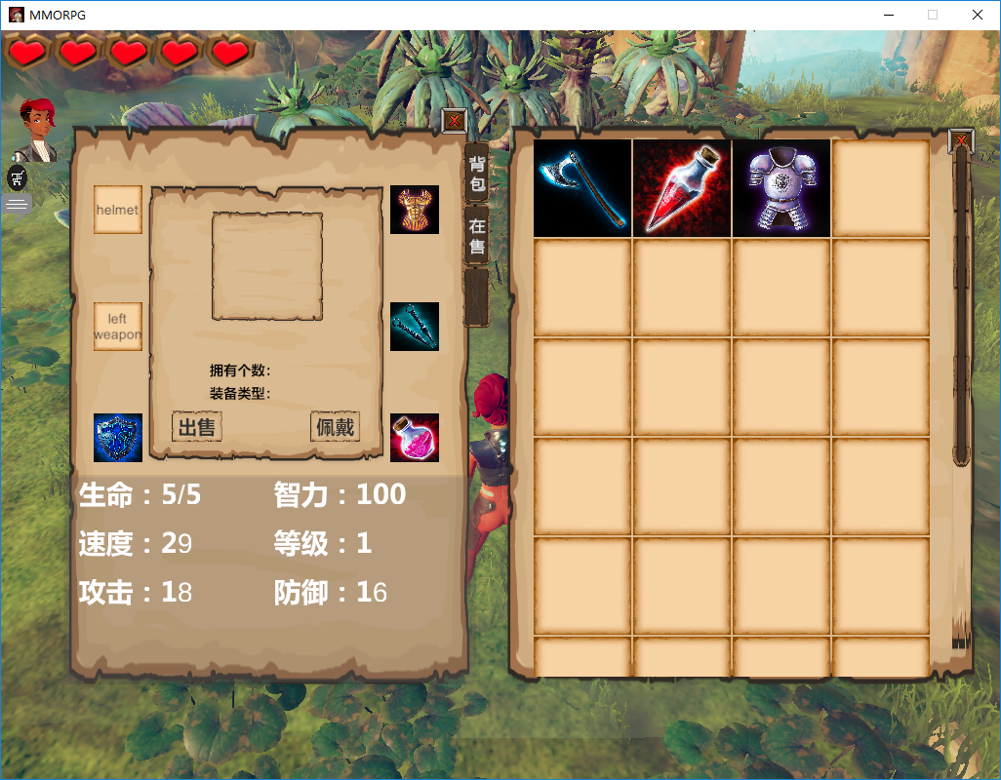
4. functions
Treasure equipment
Ware / drop
Change player attribute with treasure
update to database after closing window

Slide 18
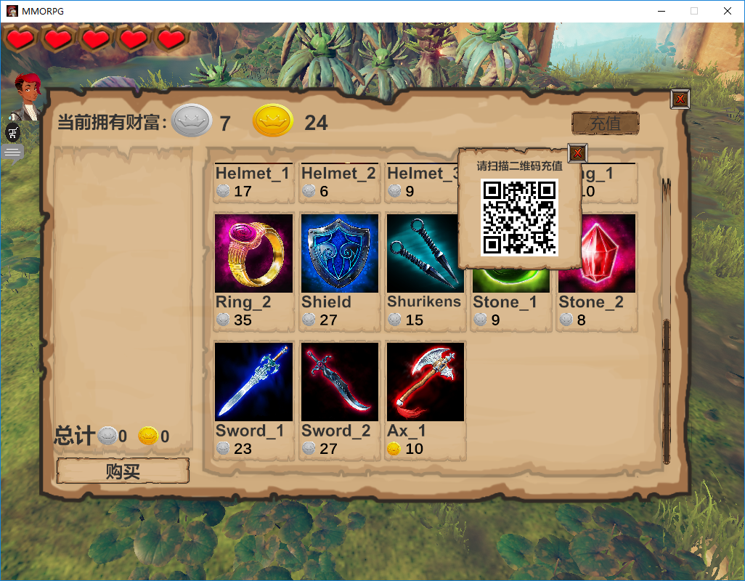
4. functions
Gold coin recharge with QR

Slide 19
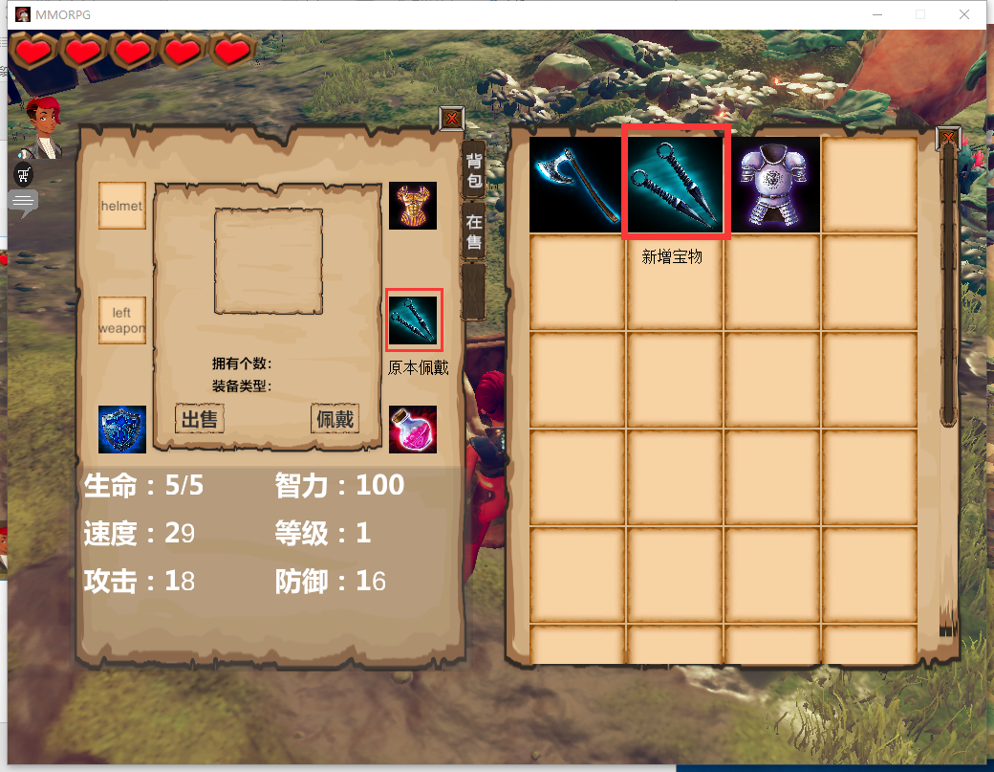
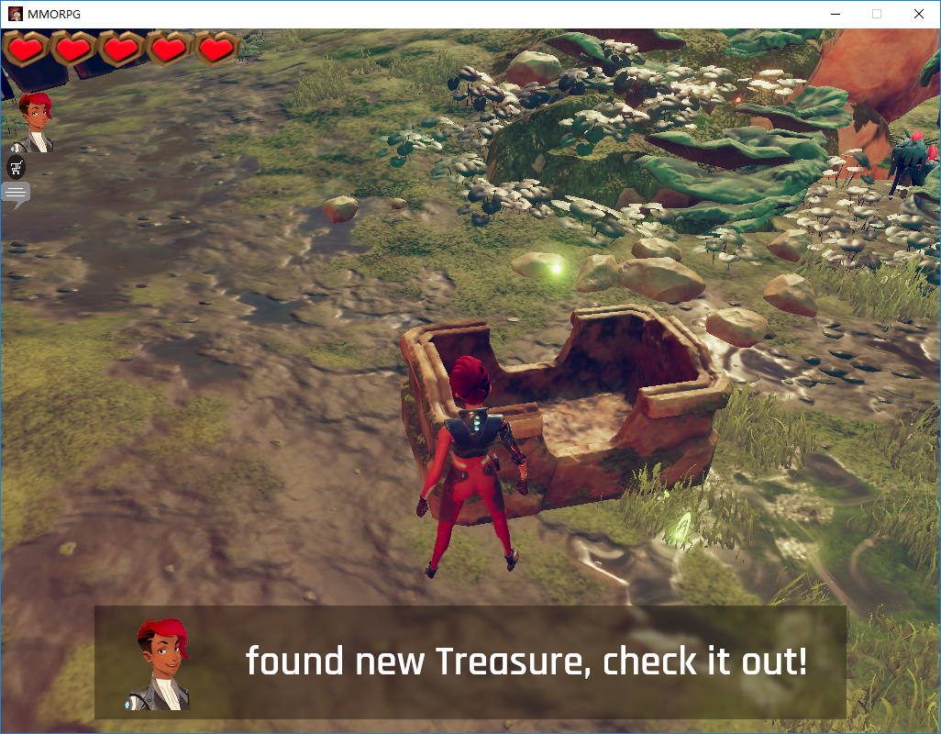
4. functions
Find treasure daily
Random treasure gain
Store found treasure in backpack

Slide 20
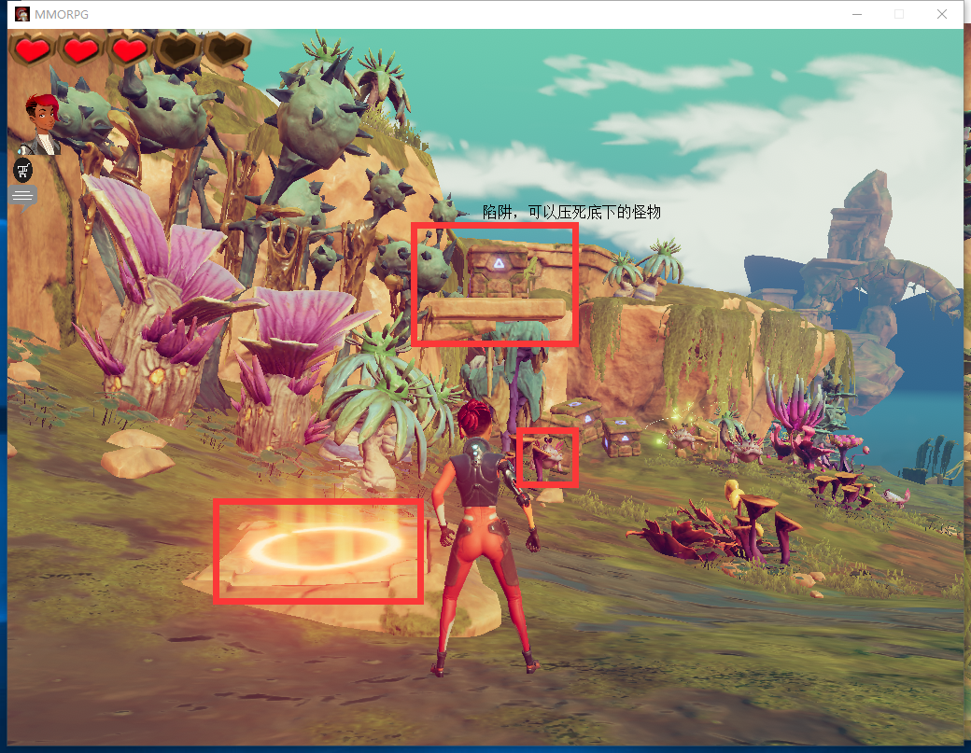
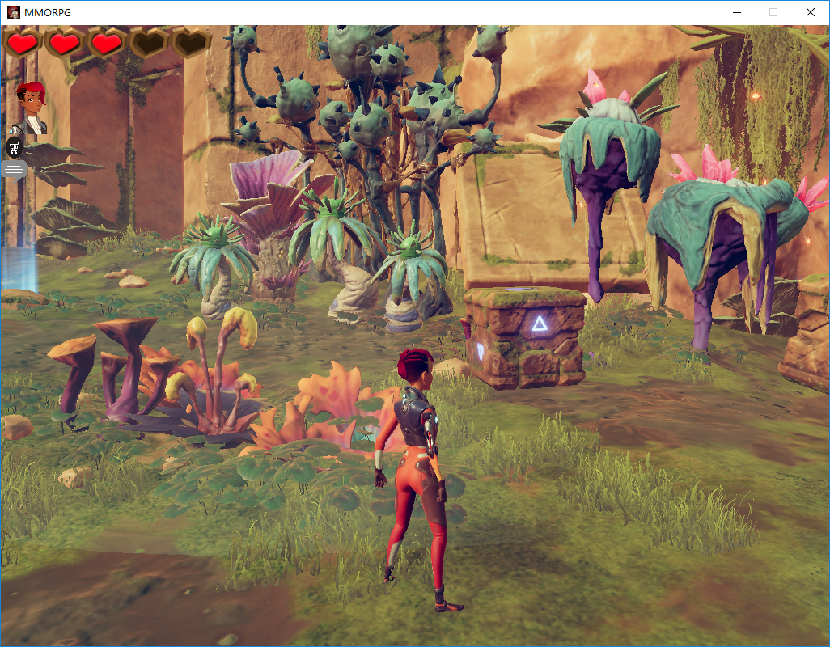
4. functions
Game trap & trick

Slide 21
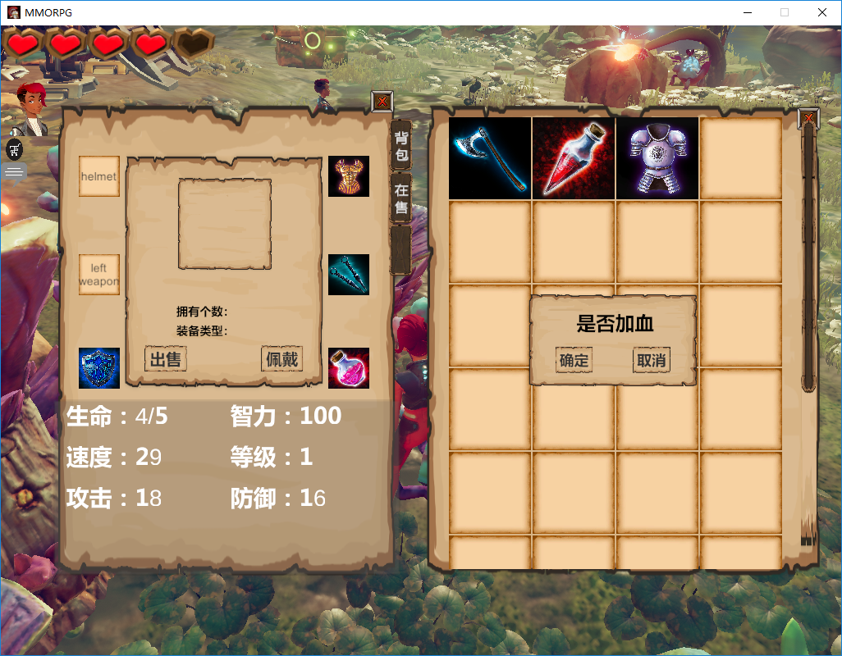
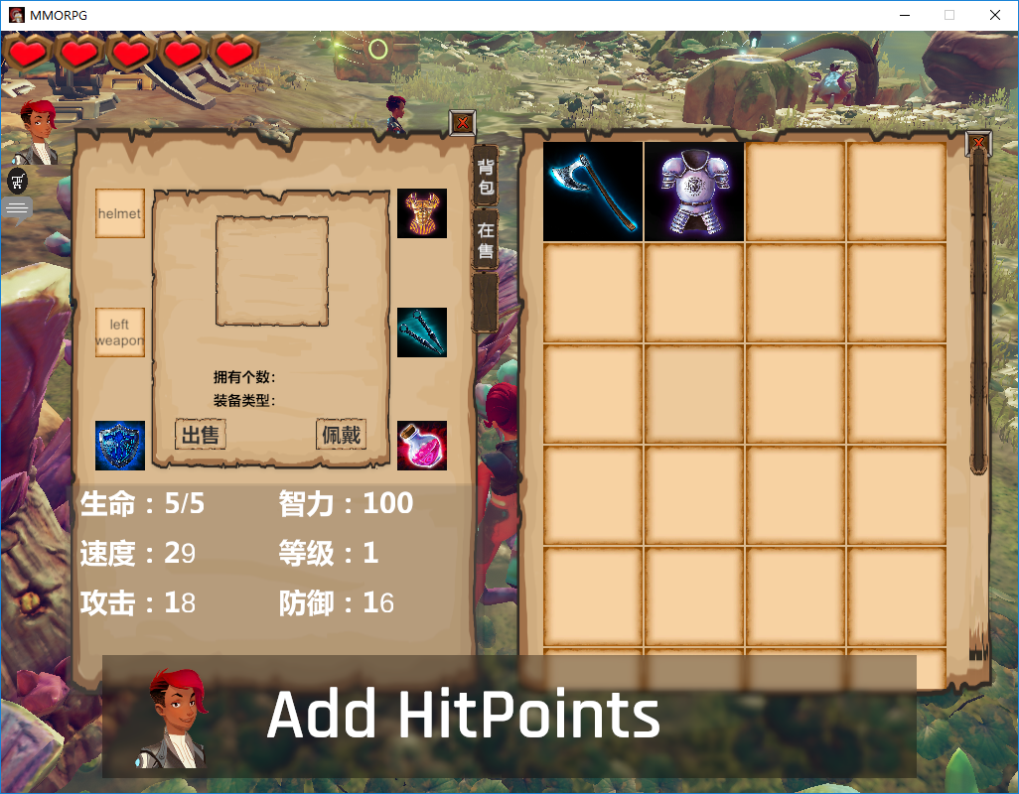
4. functions
Recover health with elixirs

Slide 22
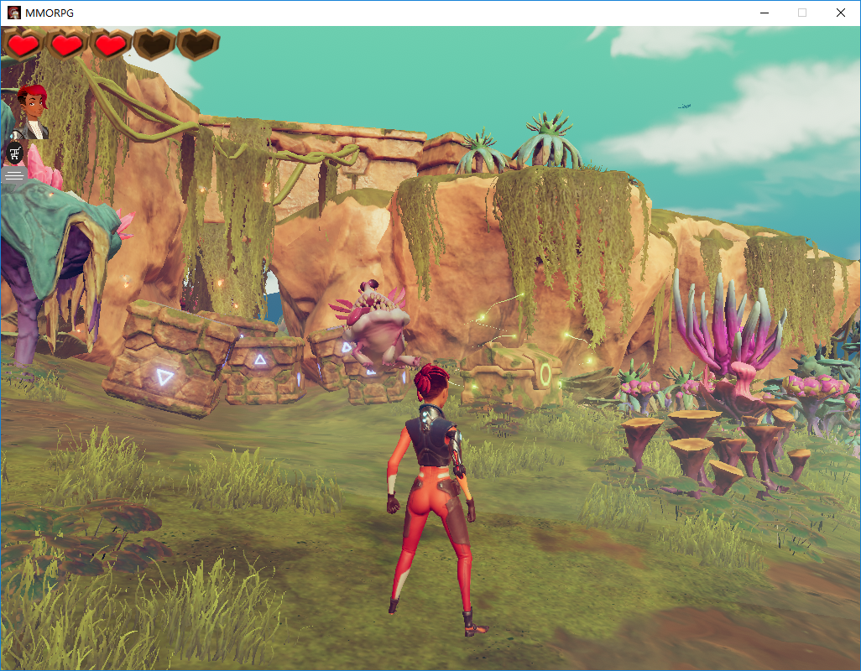
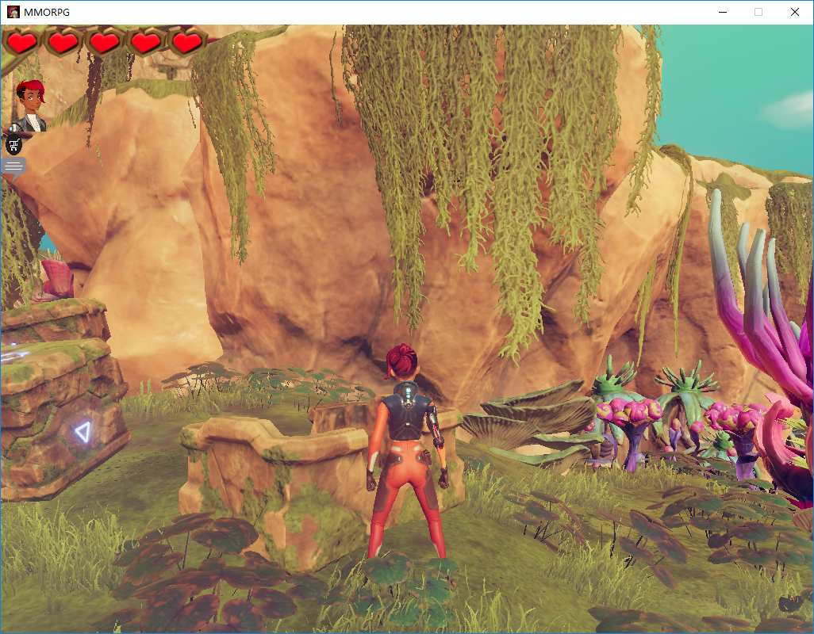
4. functions
Health box
Heal player

Slide 23
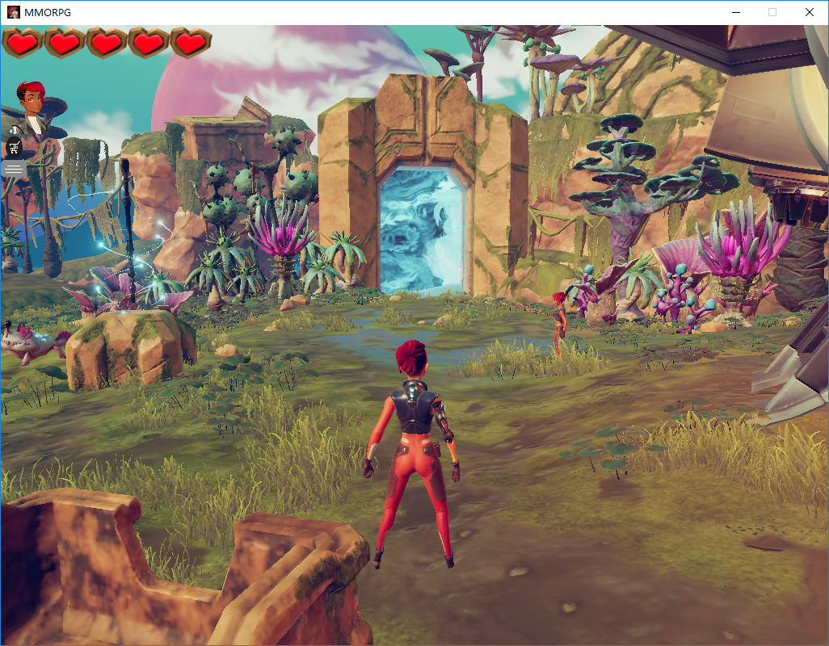
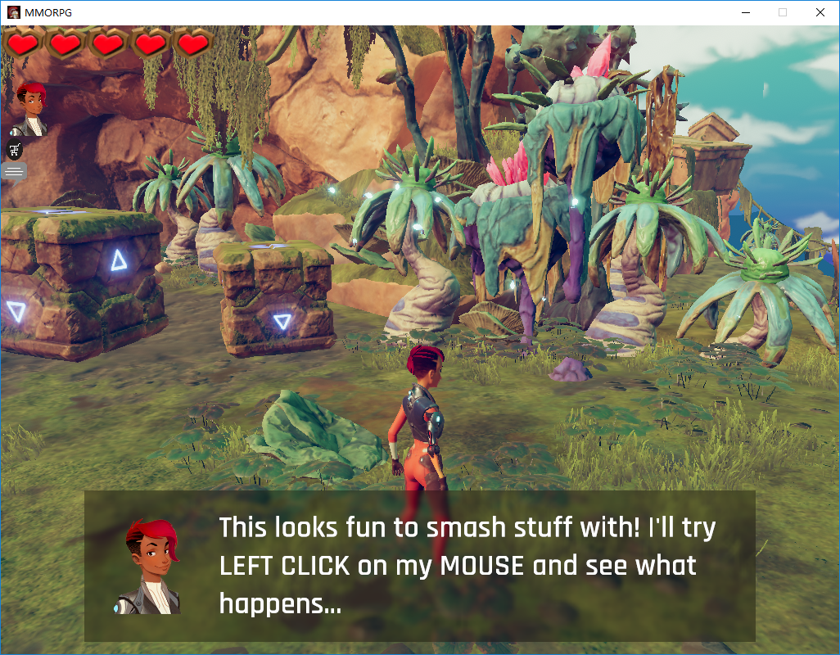
4. functions
Teleport in game
Transport player from one place to another

